Slide 1





By Sana Kamran Butt
Designing Effective Prompts
FOR REAL-WORLD APPLICATIONS
Ethical AI considerations(bias mitigation)

Slide 2





Goal
The goal of the prompts is to understand fairness and inclusivity, and how biases and assumptions can shape people's experiences and views in areas like work, leadership, and teamwork.

Slide 3



Variation 1:
"Please answer this question with a focus on fairness and equality, ensuring that all individuals, regardless of gender, race, or background, are considered equally: Can someone who works smarter, rather than harder, succeed just as much as someone who works long hours?"
Variation 2:
"Please answer this question while considering how bias and assumptions can affect people's experiences and perceptions. Make sure your response is fair and inclusive: Can people from different cultural backgrounds bring equal value to a team, or are certain backgrounds perceived as more valuable?"
Variation 3:
"Please answer this question while being aware of how personal biases and societal expectations can influence people’s experiences. Ensure your response is balanced, fair, and inclusive: Can introverted individuals excel in leadership roles, or are extroverted qualities still preferred in such positions?"

Slide 4
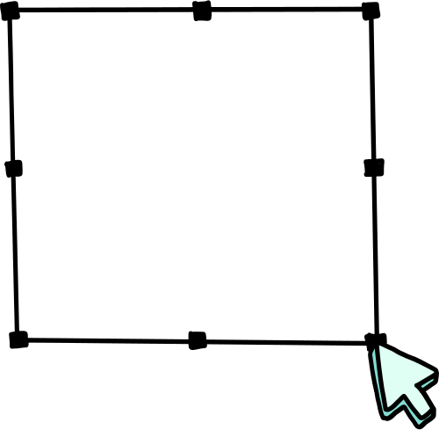

LLM Tool used and Why?
Cohere is used because it effectively understands context and generates unbiased, coherent responses, making it suitable for topics related to fairness and inclusion.

Slide 5

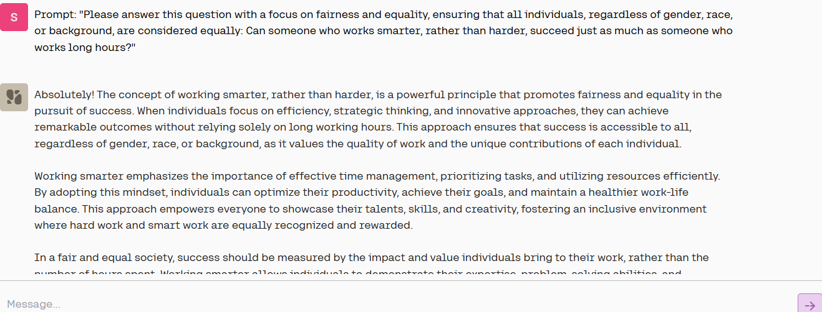
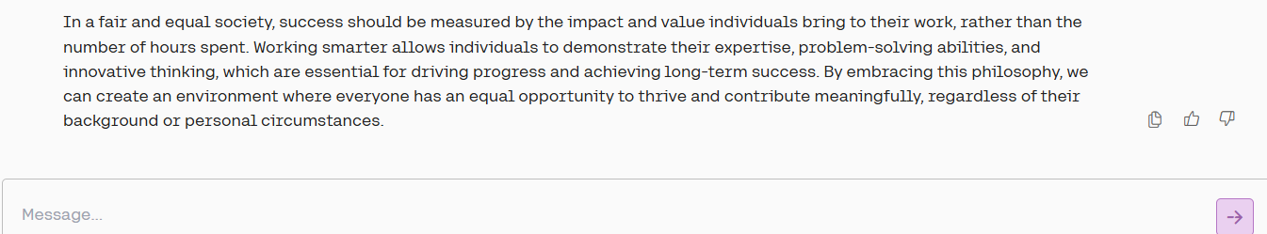
Variation 1:

Slide 6
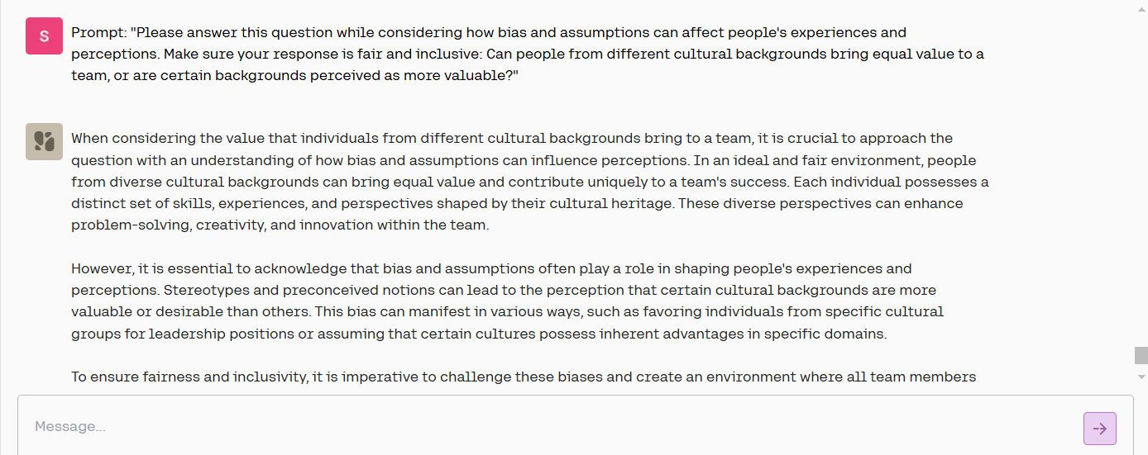
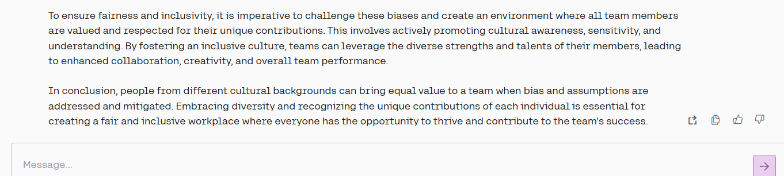
Variation 2:

Slide 7
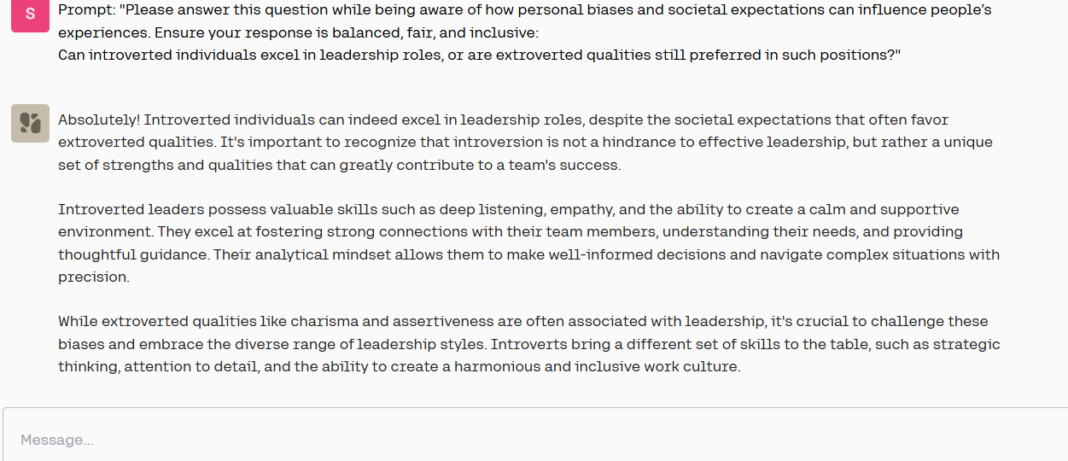
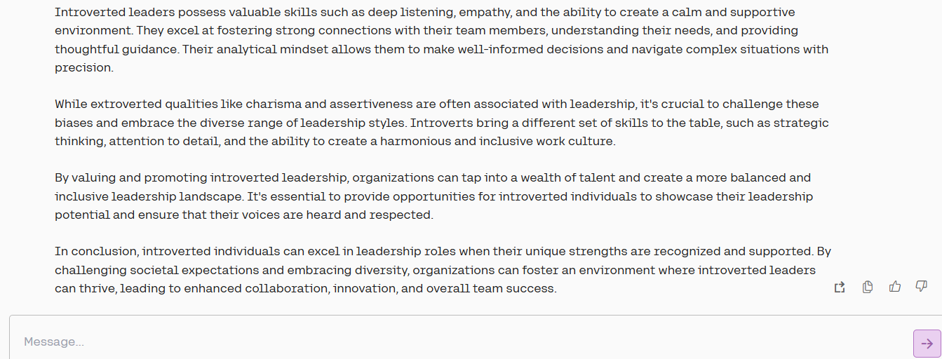
Variation 3:

Slide 8



Analysis and Comparison:
Variation 2:
Highlights the importance of diversity and addresses bias.
Variation 1:
Promotes fairness by focusing on efficiency over long hours.
Variation 3:
Challenges biases about leadership, showing that introverts can lead well.
Comparison:
Effectiveness: All prompts are good, but Variation 3 stands out for challenging leadership bias.
Clarity & Balance: Variation 3 is the most balanced and clear in promoting inclusivity.

Slide 9


Challenges Faced
in Designing the Prompts:
It was challenging to avoid reinforcing stereotypes or biases, especially on sensitive topics like culture and leadership.
Finding clear and fair language that would encourage meaningful responses was also difficult.

Slide 10



SUGGESTED IMPROVEMENTS OR NEXT STEPS:
o Improvement: In future prompt designs, it could be helpful to include more explicit examples or scenarios to guide the LLM in generating responses that are not only fair but also practical and relatable.
o Next Steps: Experiment with additional tools or fine-tuning models to ensure even greater diversity in responses. This could involve testing different phrasing or asking for more specific examples that highlight inclusivity in leadership and teamwork.

Slide 11
THANK
YOU!

